Slide 1
ENGR 1182 – Fundamentals of Engineering Graphics Preparation 07 – Handle

Slide 2
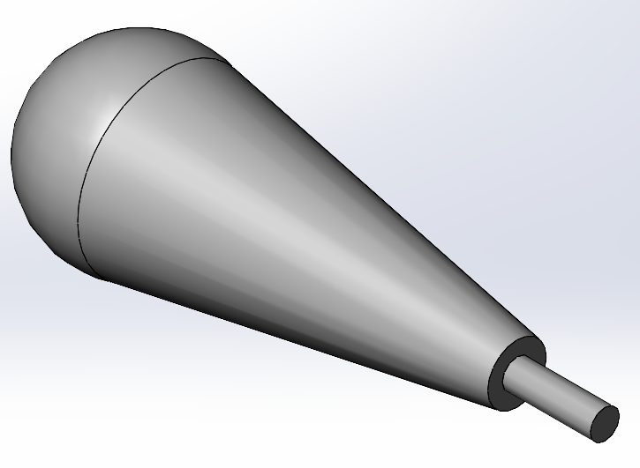
Part to be created: Handle
Purpose: Create a part in SolidWorks using the loft and dome tools
Description: Follow the SolidWorks tutorial to create the part to the right.
Deliverables: A complete handle part submitted using standard submission practices for parts.

Slide 3
SolidWorks Skills Developed:
3D Sketches
Loft
Dome

Slide 4
Introduction
The handle part will be created by drawing two planes and lofting from one plane to the other. This will be done using 3D sketches and the Loft feature. Two circles will be drawn, one on each plane. The loft will be between these two circles. Then a cylinder will be extruded from the bottom of the handle.

Slide 5
Disclaimer
This tutorial was designed using a desktop version of SolidWorks. It’s highly recommended that you attempt this tutorial on a desktop computer in Hitchcock Hall. The First Year Computer Lab, located in HI 316, is an excellent location to complete this tutorial. If you wish to use SolidWorks on a personal laptop, please keep in mind that there may be small discrepancies between what you will see on your laptop and what you see on the slides. Lastly, if you’re going to use your laptop, please, please, please use a mouse and not your laptop’s trackpad.

Slide 6
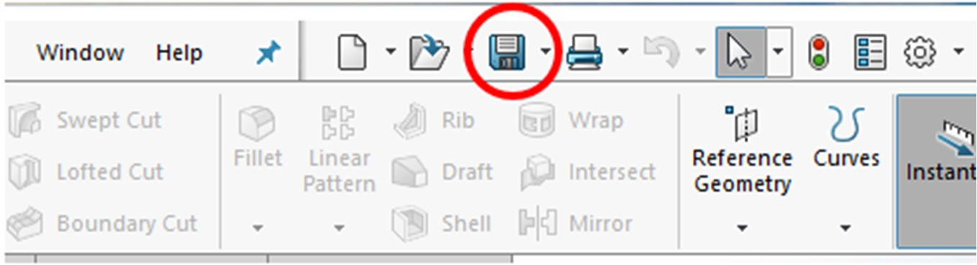
Procedure
Open SOLIDWORKS and create a new part.
Make sure the part is in English units [IPS (inch, pound, second)].
Ensure that the Overall Drafting Standard is set to ANSI.
Let’s preemptively save the part as Engine_Handle by clicking on the Save icon in the toolbar and saving it to your U drive or flash drive.

Slide 7
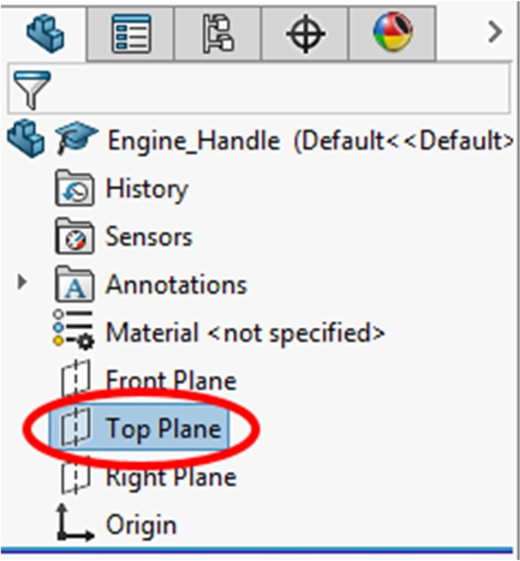
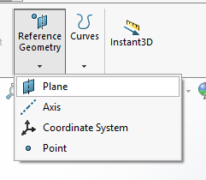
Procedure
5. In the Feature Manager Design Tree panel to the left of the workspace, click on the Top Plane.
6. Then, click on the Reference Geometry dropdown found under the Features tab and select Plane.

Slide 8
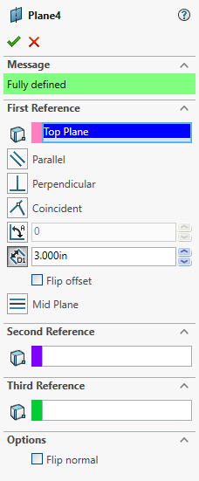
Procedure
7. The Plane panel will appear to the left of the workspace with the Top Plane listed under First Reference.
8. Set the distance from the Top Plane to 3 inches. A blue rectangle will appear above the Top Plane in the workspace to give a preview of where the new plane will be located.

Slide 9
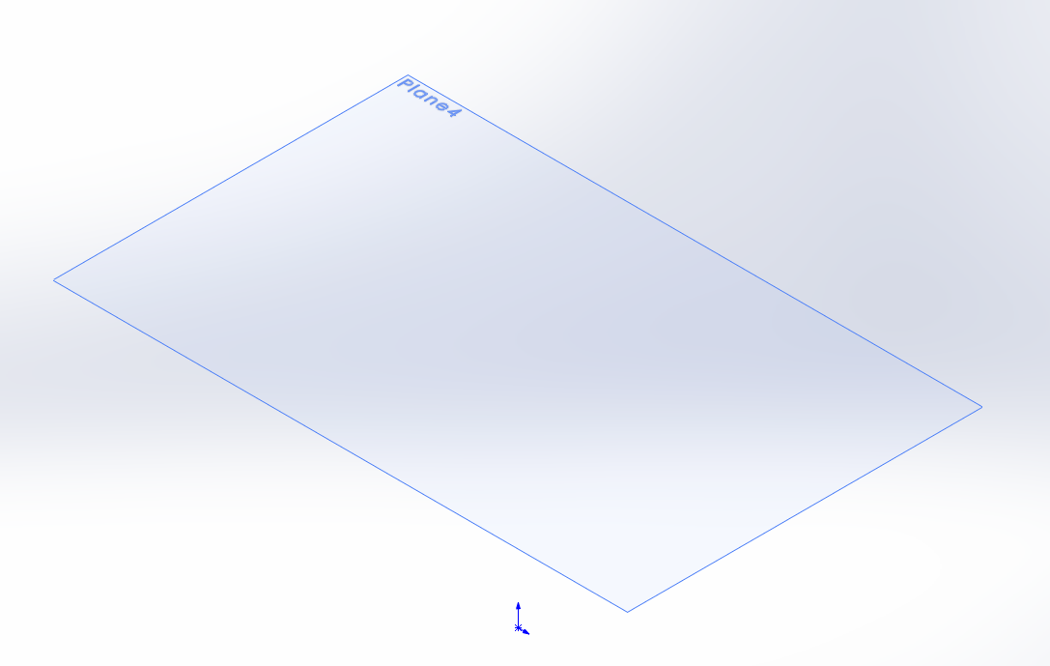
Procedure
9. Click on the green checkmark in the Plane panel. The workspace should now look like the image below.

Slide 10
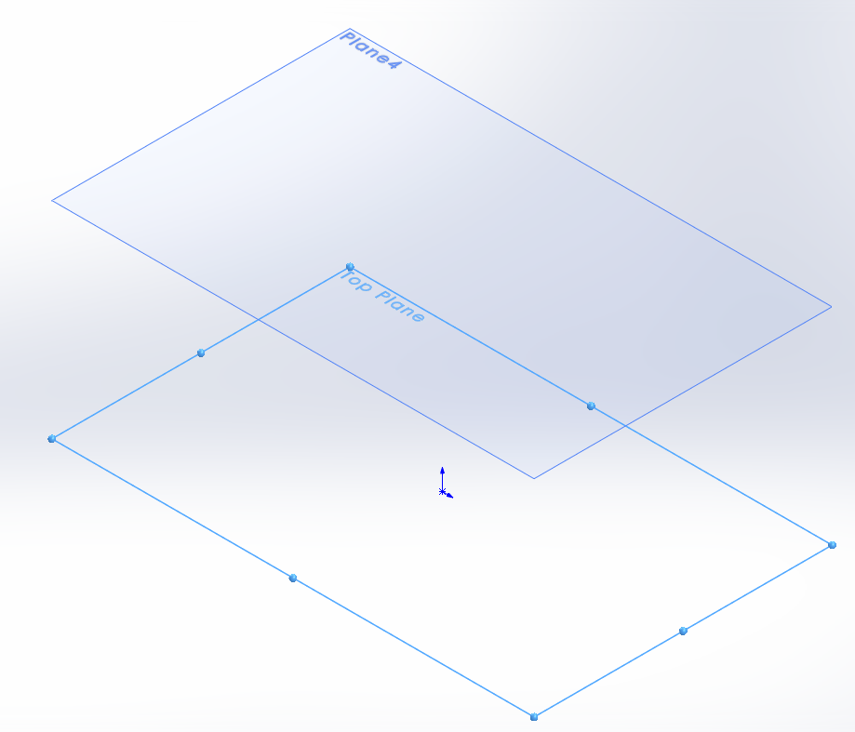
Procedure
10. In the Feature Manager Design Tree panel to the left of the workspace, click on the Top Plane again and you should see both planes as shown to the right.
11. While still on the Top Plane, click on the Sketch icon in the Sketch tab to create a new sketch on that plane.

Slide 11
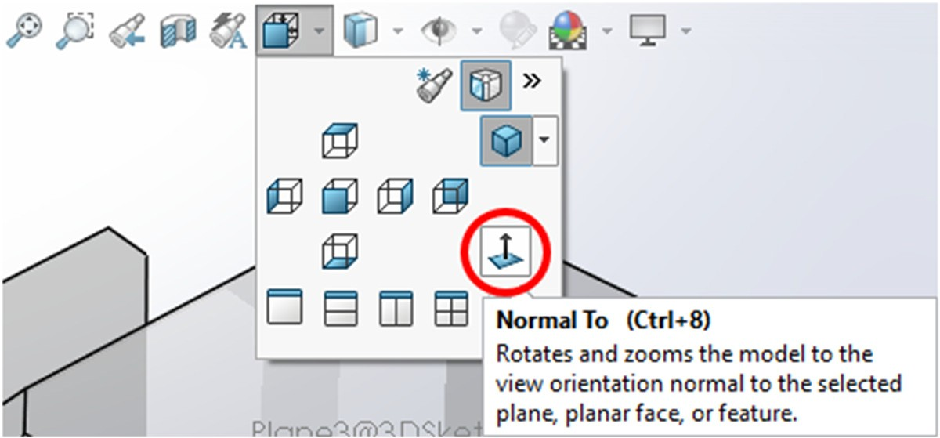
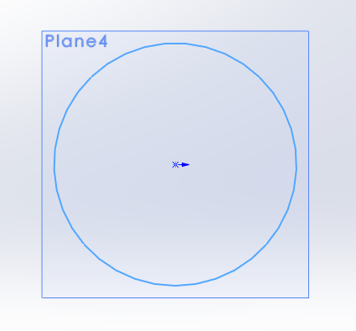
Procedure
12. Use the Normal To icon in the View Orientation menu to view the sketch directly if it does not automatically rotate.
13. Create the sketch shown in the image to the right of a circle centered at the origin with a diameter of 0.5 inches. Accept the sketch by clicking the Exit Sketch icon.
Note: It will appear as though this sketch is on the new plane that we added, but it is underneath it on the top plane. This is because the sketch plane you selected was the top plane, not the new upper plane.

Slide 12
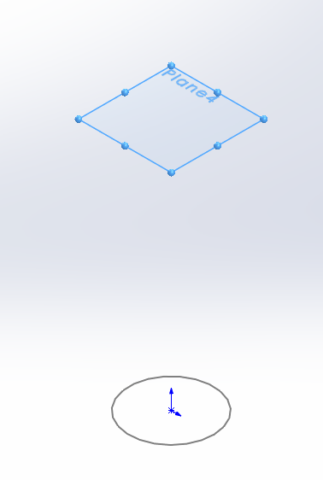
Procedure
14. Set the view back to Isometric. Then, to start a sketch on the upper plane click on the outline of the plane. After clicking, the plane should like what is shown on the right. Then under Sketch, select the Sketch icon and select (CTRL+8) to create a head on view.

Slide 13
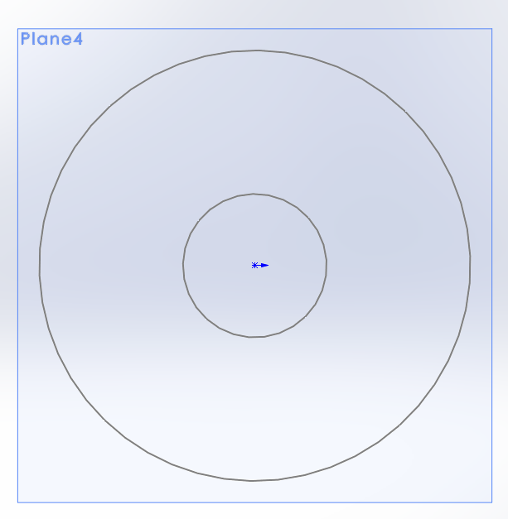
Procedure
15. Create the sketch shown in the image to the right with the proper dimensions. This sketch should have one circle centered at the origin with a diameter of 1.50 inches. The image to the right shows the visible sketch previously made on the lower plane in addition to the new sketch.
16. Exit the sketch. Then, go back to Isometric view.

Slide 14
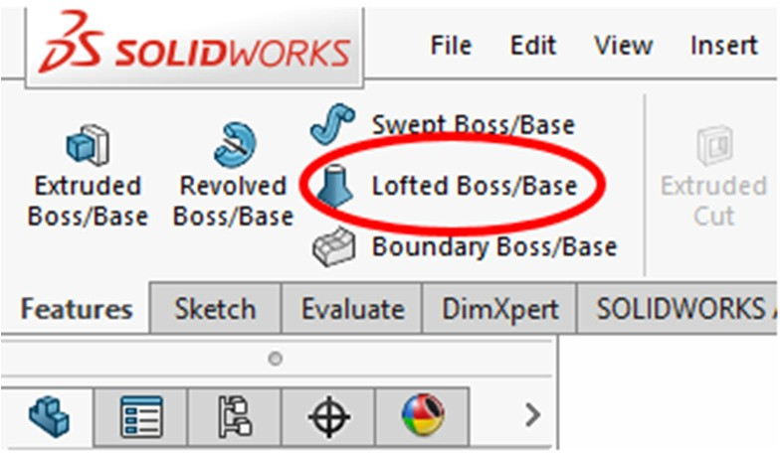
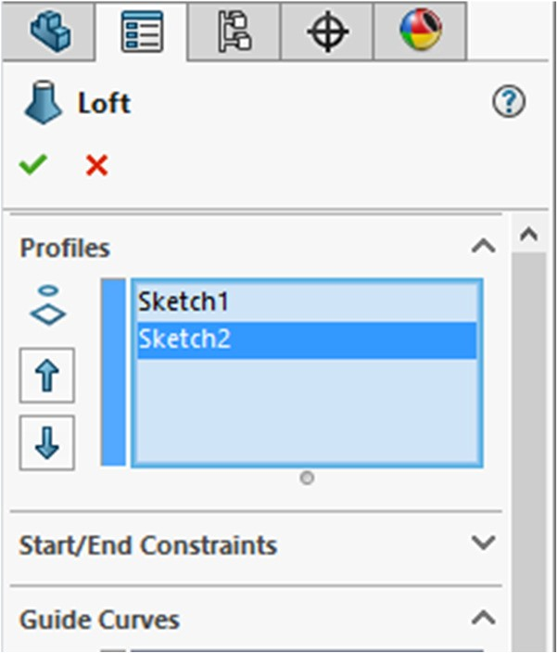
Procedure
17. Click on the Features tab. Select the Lofted Boss/Base command to connect the two circles.
18. The Loft panel should appear to the left of the workspace.
19. Make sure that both sketches are listed in the Profiles window. If they are not, click on the circumference of the circle on the sketches that are missing.

Slide 15
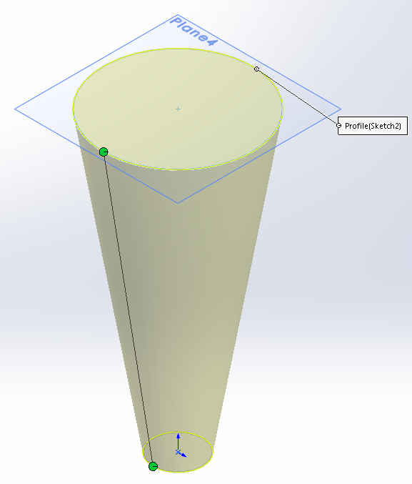
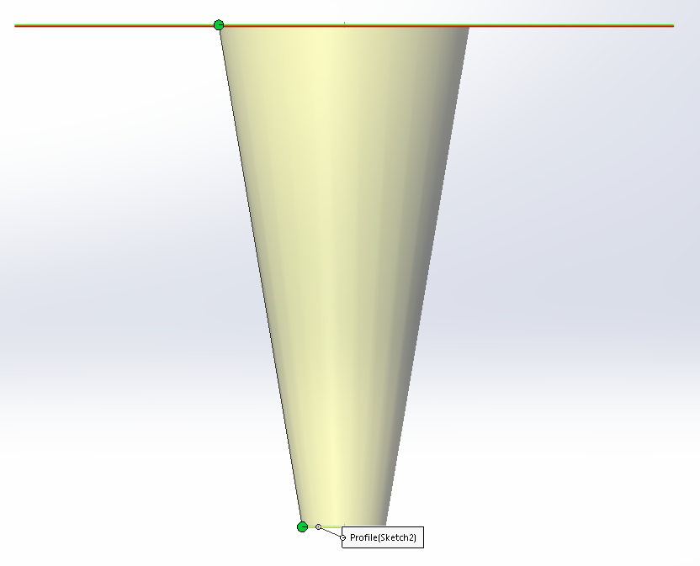
Procedure
20. You should see a preview of the loft that matches the image shown to the right. If your loft contains a twist, move the top or bottom circle so that the line is straight. It's helpful to look at it from the side to do this.
21. Click on the green checkmark to confirm the loft.

Slide 16
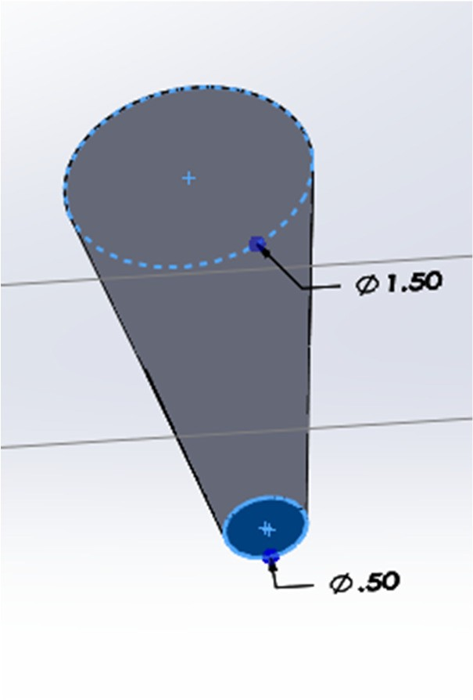
Procedure
22. We're now going to make the small cylinder at the base of the loft. Rotate the object to look at the bottom surface of the handle. Start a sketch on the bottom surface, highlighted in blue in the image to the right.

Slide 17
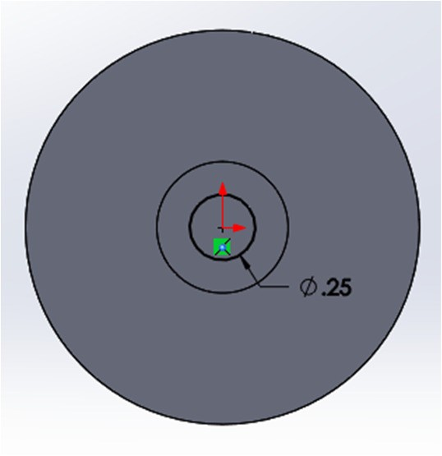
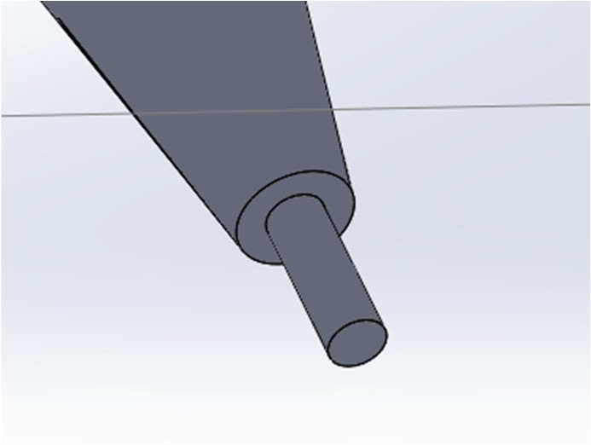
Procedure
23. Sketch a circle at the origin with a diameter of 0.25 inches.
24. Finish the sketch and extrude the circle 0.75 inches using the Extruded Boss/Base from the Features tab. The extruded feature should look like the image to the right.

Slide 18
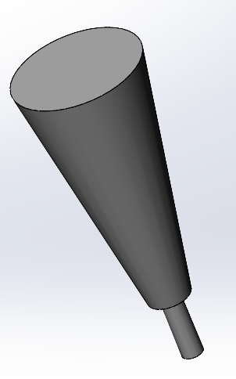
Procedure
25. Now, the end of the handle needs to be added. To do so, first rotate the object into an orientation in which you can see the top surface of the handle, similarly to that shown in the image to the right.
26. Then, click on the Features Tab.

Slide 19
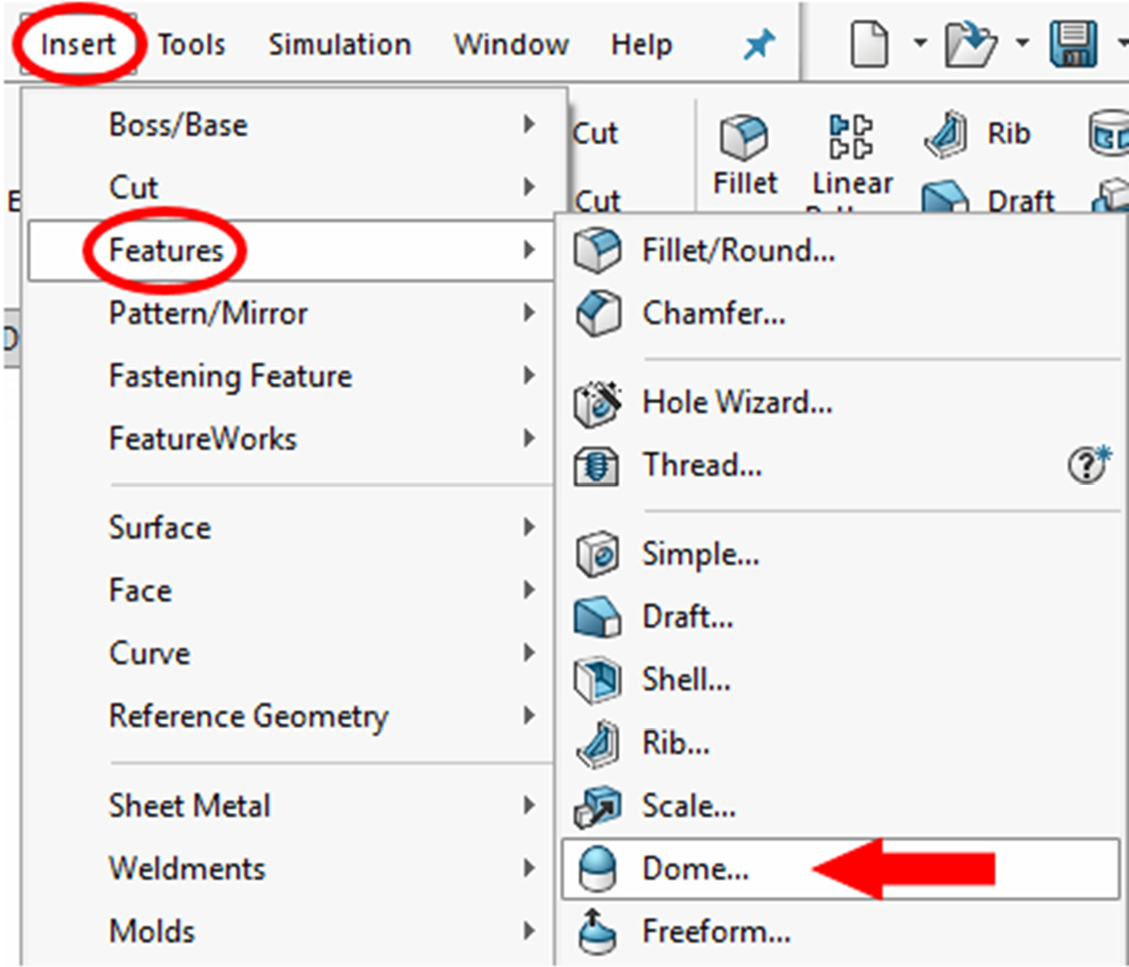
Procedure
27. Select the Dome feature in the Features tab. It will be signified by a white cylinder topped with a blue rounded surface.
28. If the Dome feature does not appear in the Features tab, click on Insert, and then Features. Select Dome.

Slide 20
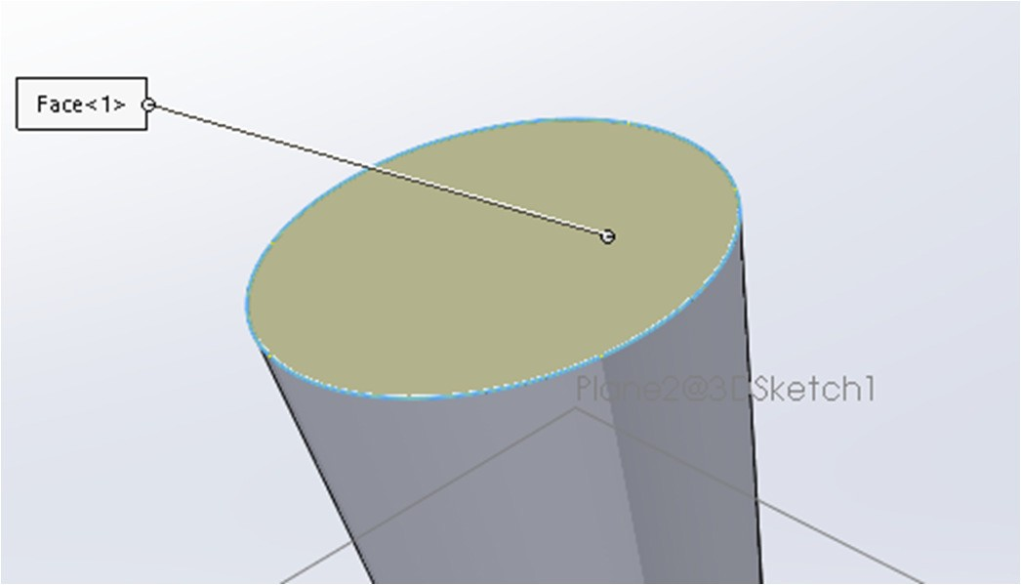
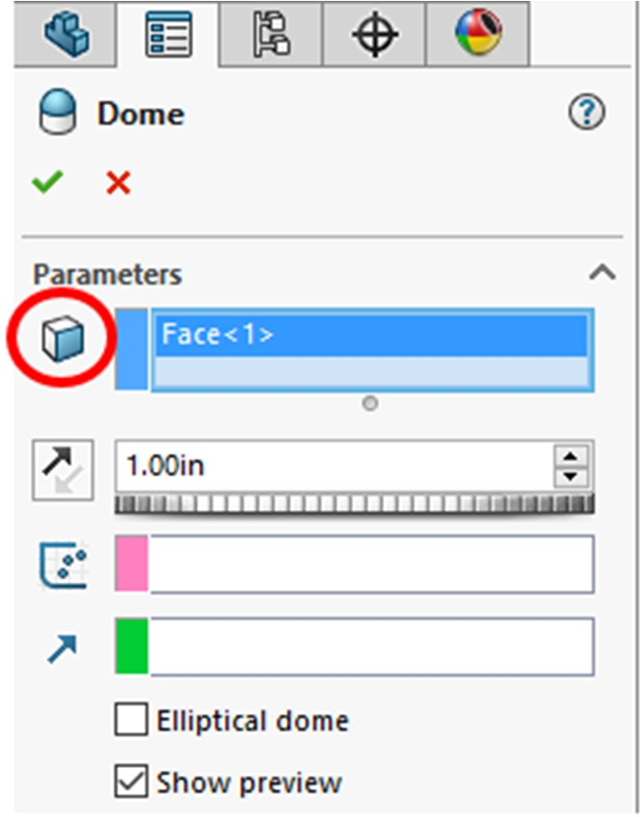
Procedure
29. Select the top face of the handle, shown highlighted in yellow in the image to the right.
30. In the Dome panel that appears to the left of the workspace, Face<1> will appear under Parameters in the Faces to Dome window.
31. Set the Dome Dimension to 1.00 inch. Accept the dome by clicking on the green checkmark.

Slide 21
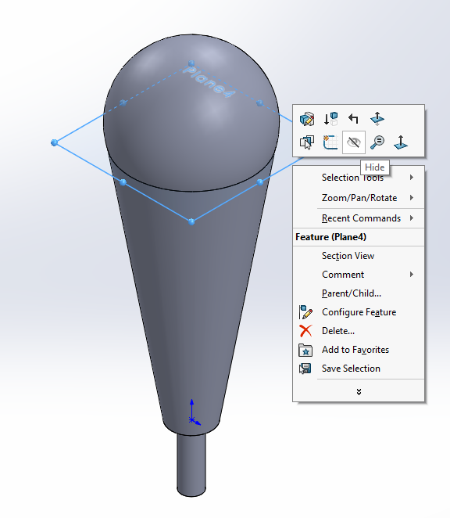
Procedure
32. In Isometric view, the handle should now look like the image to the right.
33. As you can see, the plane you created is still visible.
34. To hide this plane, right click on the plane and hit the hide option that appears as an eye.

Slide 22
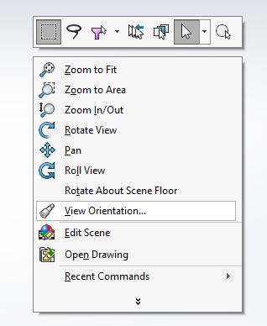
Procedure
35. Now, the handle of the part is complete. Put the part in Isometric view. Save the part to your U drive or flash drive before proceeding.
36. You may be saying to yourself that we still need to put our object into the most characteristic view, and you would be right! To do that, right click in the workspace.
37. In the window that pops up, click on View Orientation.

Slide 23
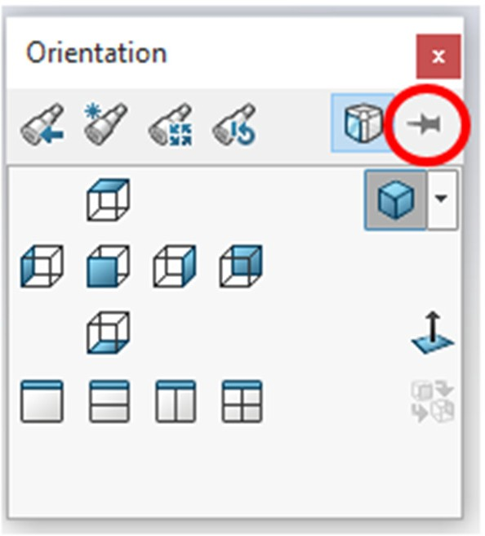
Procedure
38. Click on the push pin in the Orientation window that comes up to keep the window available. In some cases, the button may be cut off. You should still be able to click on it.
39. To redefine the Front View of the part, you need to orient the part into the new Front view. To do so, double click on the other views in the panel.
40. You will notice that none of these views will produce the Front View that is best for the part.

Slide 24
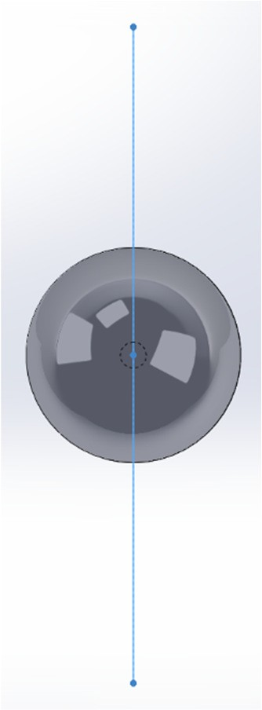
Procedure
41. Double click on the Front view again. Click on the Right Plane in the Feature Manager Design Tree to show the plane in the workspace.
42. Click on the down arrow on the keyboard six times, or until the view looks like that shown in the image to the right.

Slide 25
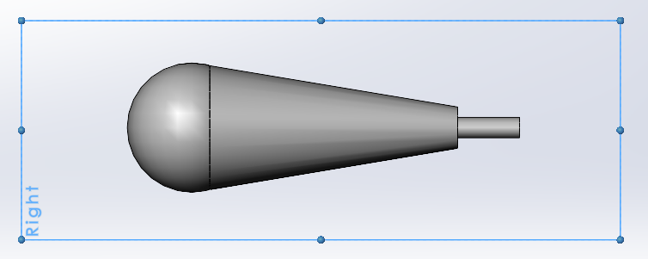
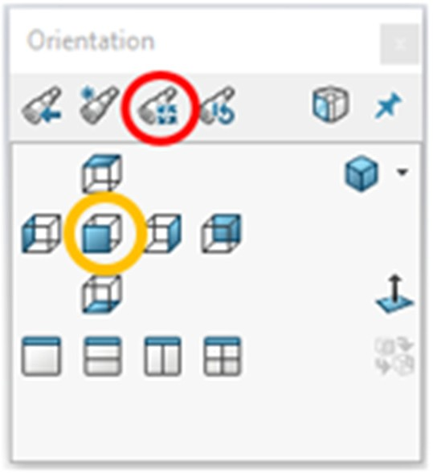
Procedure
43. Then, click on the left arrow six times, or until the view looks like that shown in the image to the right. This view will be the new front view of your part.
44. Then, click on the Update Standard Views icon, circled in red in the image to the right.
45. Then, click ONCE on the Front view in the Orientation panel, circled in yellow in the image to the right.

Slide 26
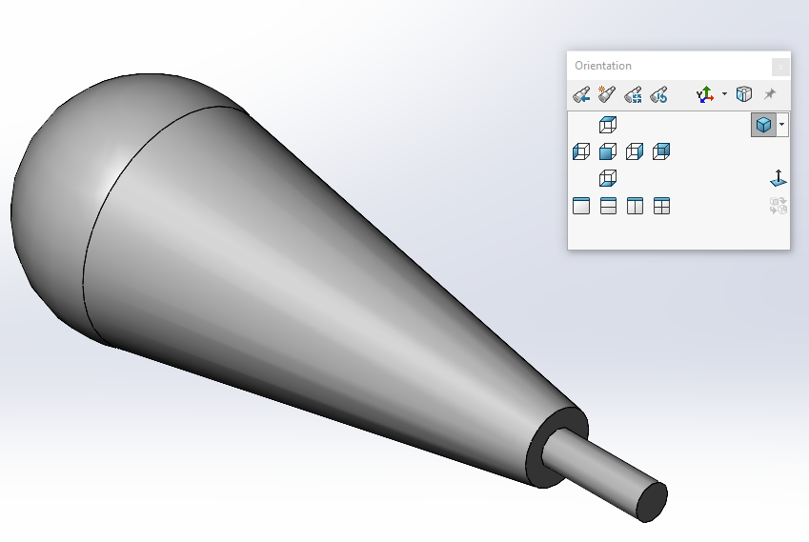
Procedure
46. When the window pops up asking if you want to make the change, click Yes.
47. Then, double click on the *Isometric view. The new isometric view should be oriented similarly to that shown in the image to the right.
48. Click on the X to close the Orientation window.
49. Save the part before you proceed.

Slide 27
Deliverables:
A handle part submitted using standard submission practices for parts.

